Slide 1
Designing and Building Smart Privacy Assistants for Improving Data Dashboards
Bachelor Thesis Project Presentation
By: Saamira Yasmin 19CH10039
Supervisor: Prof. Mainack Mondal, IIT Kharagpur

Slide 2
What are Data Dashboards?
Data Dashboards are data management tools that store user data and are used by organizations for improving service. They provide users with control of deleting personal data saved in theses dashboards.
Most of us use voice assistants like Amazon’s Alexa, Apple’s Siri or Google’s Voice Assistant in our everyday lives. But, how frequently do we open the data dashboards where all the user data gets stored in the form of transcripts, audio clips and location of use.

Slide 3
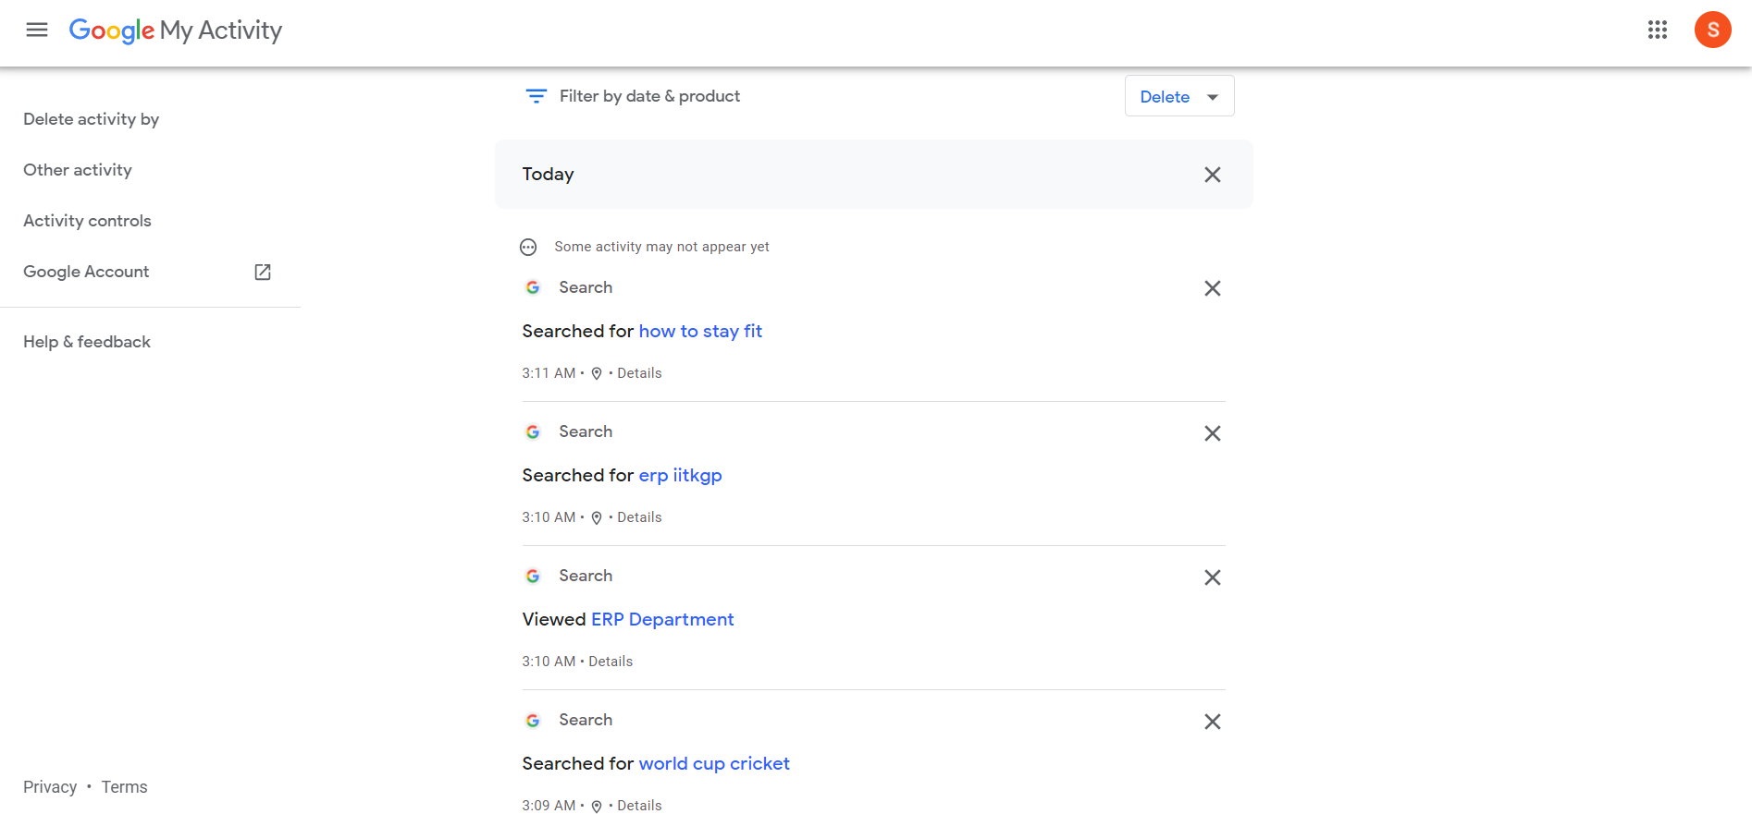
Google’s My Activity Dashboard

Slide 4
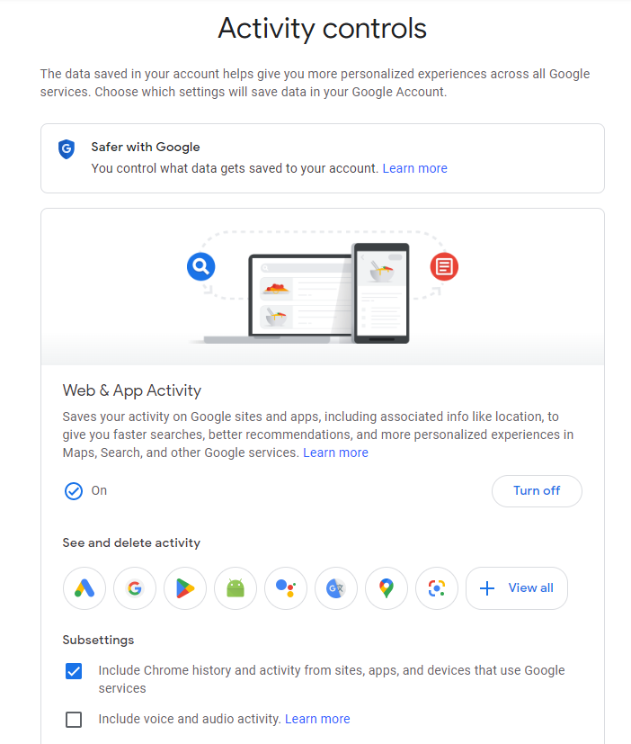
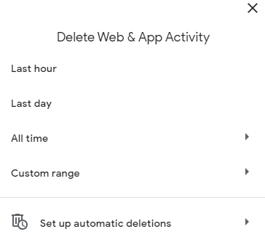
Why do we need Smart Privacy Assistants?
Google provides its own My Activity Dashboard that stores user data but it provides minimal privacy control options to its users.
We need a more user-friendly
dashboard which intimidates
users with sensitive data items.

Slide 5
Idea to Implementation
Our aim was to build a recommender system that flags data elements as sensitive or not on the users’ dashboard and addresses users’ privacy concerns. We built a Chrome extension that the user can install in his browser and achieve sensitivity analysis for all the data stored in his dashboard.
Key components of the plug-in:
Scraper to scrape user data from My Activity Dashboard
XGBoost ML Model in Backend Server
Content scripts and background scripts that get triggered on extension installation or icon click

Slide 6
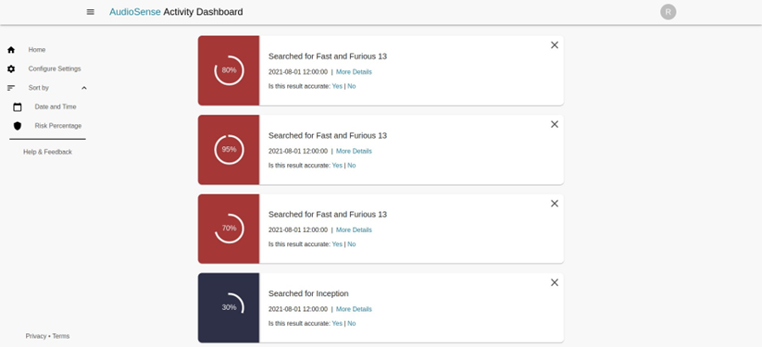
Sensitivity Classification Model
We built a continual learning based XGBoost model that outputs the risk percentages for various dashboard data elements and classifies data as sensitive or not.
XGBoost is a supervised, decision tree
based Machine Learning algorithm
and is used for classification of
data.

Slide 7
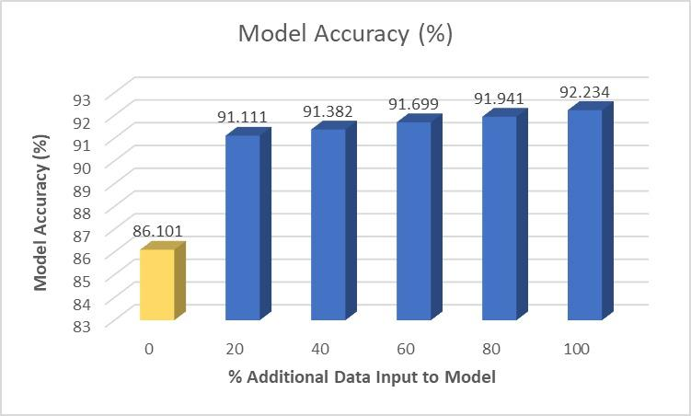
Continual Learning
We have used continual learning over the base XGBoost model for improved prediction results.
The model gets re-trained based on the user feedback and new predictions are made based on both old dataset and new dataset.

Slide 8
Backend Server
The back-end server is developed in Django and is used for the following purposes:
Training the ML model using user features
Continual re-training of the ML model using user’s feedback

Slide 9
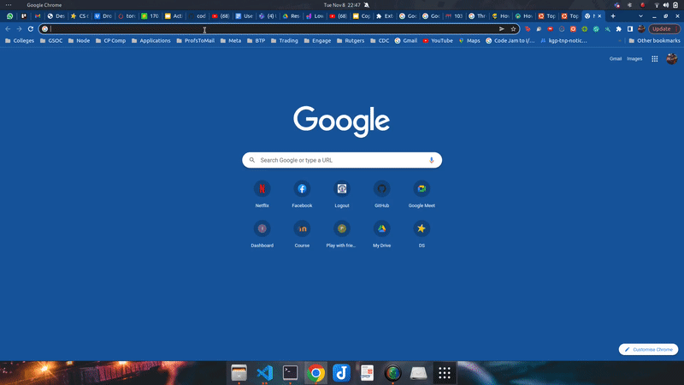
Demo of the plug-in

Slide 10
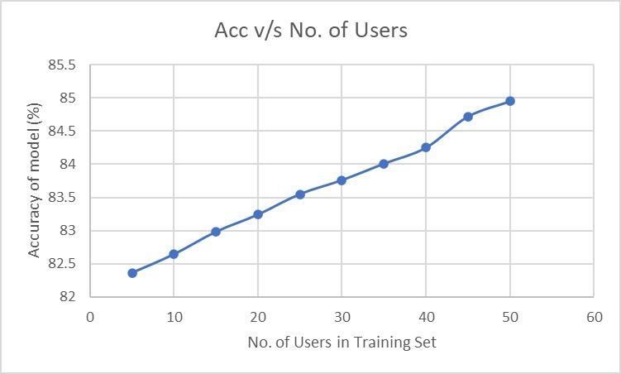
Results
We produced sensitivity prediction results for data stored in the My Activity Dashboard.
The continual model improved upon
the XGBoost model to give 92.23%
accuracy on the test dataset.
We observed that the base model
improved with increase in user data.

Slide 11
Challenges Faced and Proposed Solutions
Loading the XGBoost model JSON file in the extension
We used the ml-xgboost library to load the model
The library exported a promise in ES5 format
Browser uses ES6 version of JavaScript
Resolved the issue by cloning and implementing the ES6 version of the library
Memory storage issues with the model
It becomes difficult to load a heavy model in the extension
Performed model compression and achieved model with less than 100kB memory space

Slide 12
Future Work
We are yet to test the model for actual user feedback and evaluate the efficacy of continual learning.
We are yet to assess the time required for the model to predict results and get re-trained. We would then have to compare the results with some baseline to decide the performance of our recommendation system.

Slide 13
THANK YOU!

